Slide 1
Chapter 4.1 Defensive Programming
CCSW 325 (Software Construction)
Notes:
Last Update: 22/8/2019
Version 1.0

Slide 2
Outline
Defensive Programming (Part 1 of 3)
Protecting Your Program from Invalid Inputs
Assertions

Slide 3

What is Defensive Programming?

Slide 4
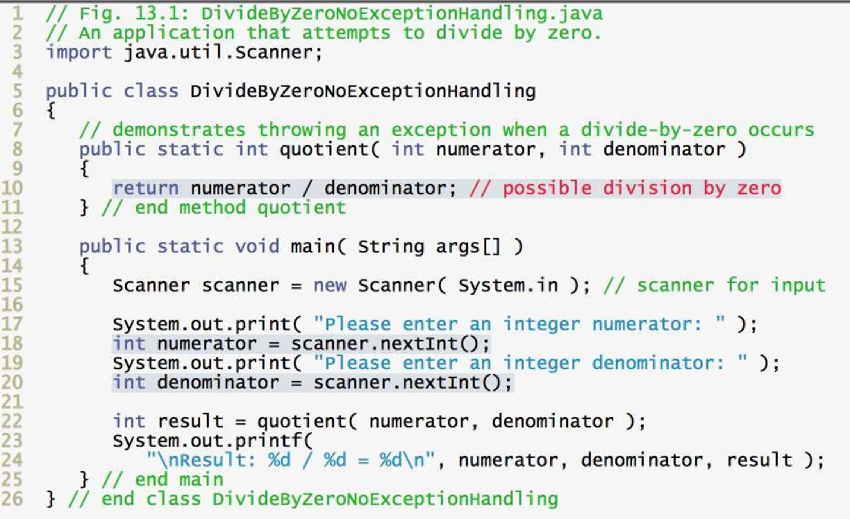
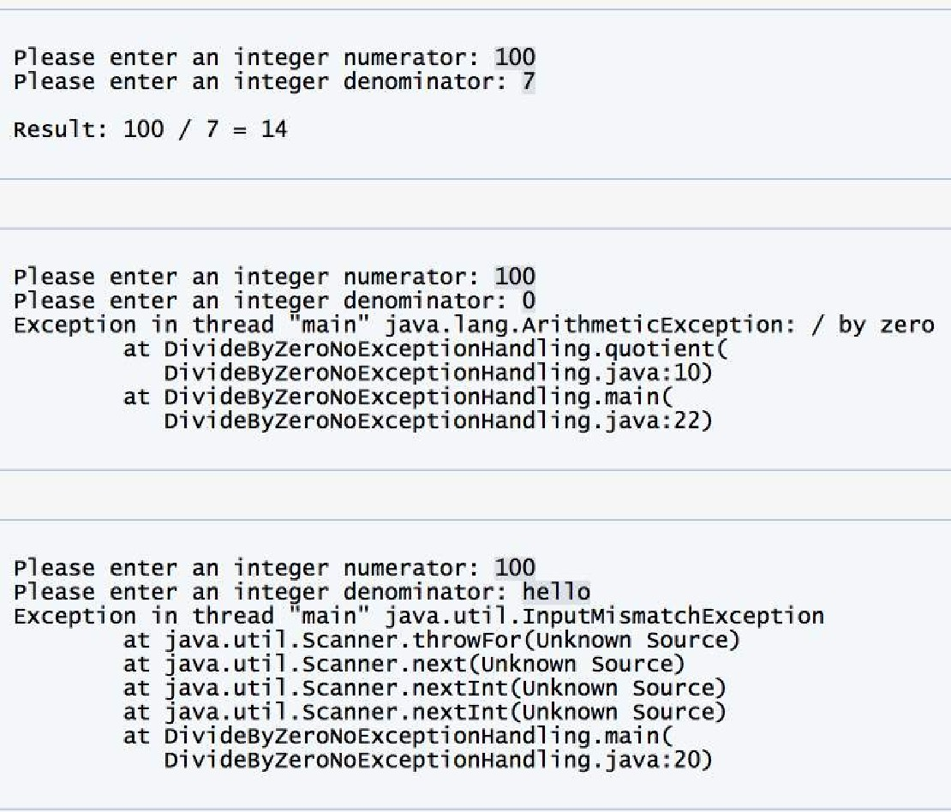
What is Defensive Programming?

Slide 5
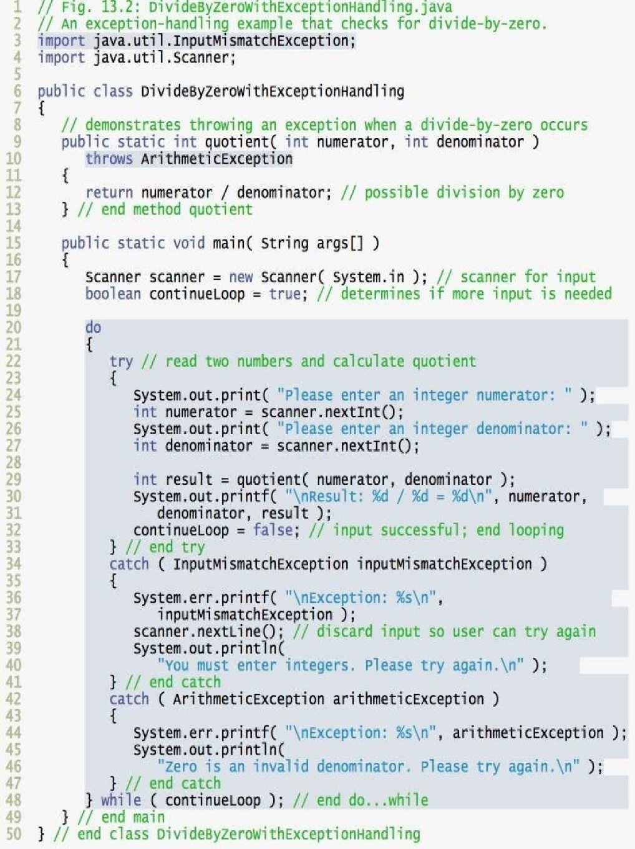

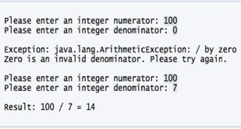

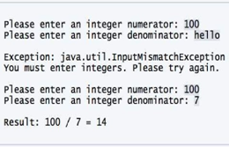
What is Defensive Programming?
Protecting Your Program from Invalid Inputs

Slide 6

Protecting Your Program from Invalid Inputs

Slide 7
Protecting Your Program from Invalid Inputs
For production software, garbage in, garbage out isn’t good enough. A good program never puts out garbage, regardless of what it takes in.
1- Assertions
2- Error handling
3- Exceptions
Notes:
Assertions are primarily used for debugging and verifying assumptions during development.
Error handling and exceptions are used to manage unexpected or exceptional situations during runtime and maintain program stability.

Slide 8
Assertions
An assertion is code that’s used during development—usually a routine or macro—that allows a program to check itself as it runs
When an assertion is true, that means everything is operating as expected. When it’s false, that means it has detected an unexpected error in the code.
Assertions are especially useful in large, complicated programs and in high-reliability programs.

Slide 9
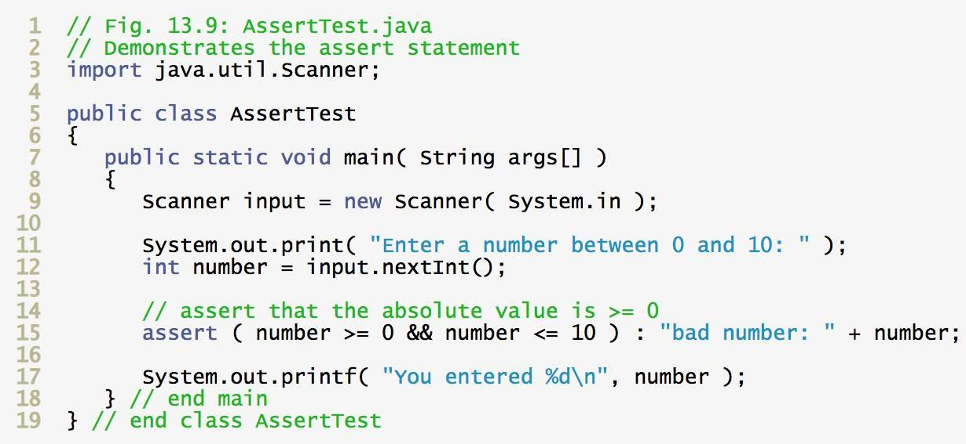
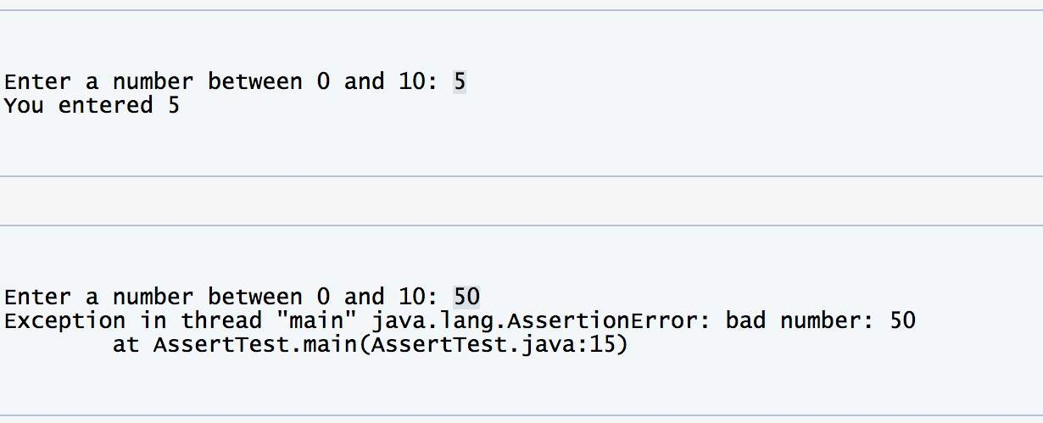
Assertions
An assertion usually takes two arguments: a Boolean expression that describes the assumption that’s supposed to be true, and a message to display if it isn’t.

Slide 10
Assertions: Guidelines for Using Assertions
Use error-handling code for conditions you expect to occur; use assertions for conditions that should never occur
Assertions check for conditions that should never occur.
Error-handling code checks for off-nominal circumstances that might not occur very often, but that have been anticipated by the programmer who wrote the code and that need to be handled by the production code.
Error handling typically checks for bad input data; assertions check for bugs in the code.

Slide 11

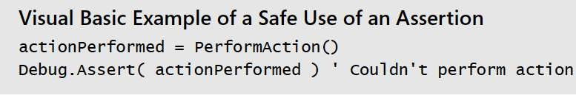
Assertions: Guidelines for Using Assertions
Avoid putting executable code into assertions
Putting code into an assertion raises the possibility that the compiler will eliminate the code when you turn off the assertions.

Slide 12
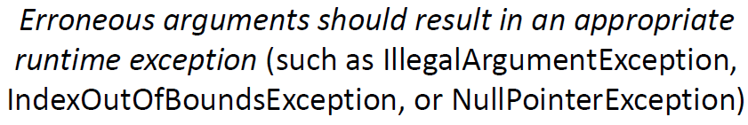
Assertions: Guidelines for Using Assertions
Do not use assertions for argument checking in public methods
Argument checking is typically part of the published specifications (or contract) of a method, and these specifications must be obeyed whether assertions are enabled or disabled

Slide 13
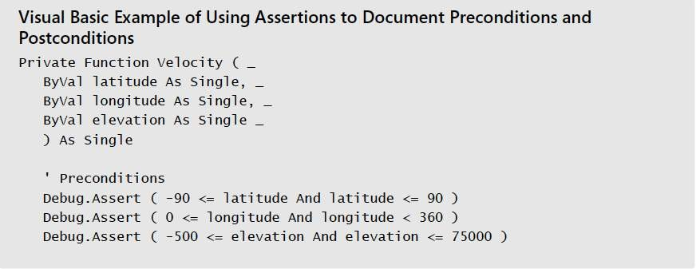
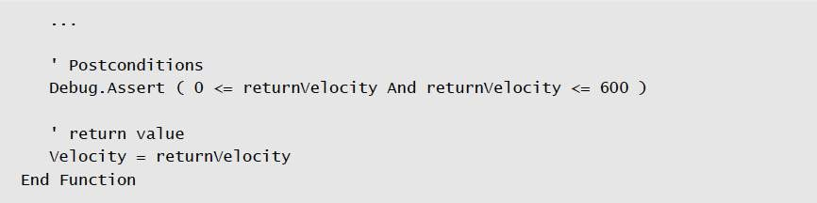
Assertions: Guidelines for Using Assertions
Use assertions to document and verify preconditions and postconditions
Preconditions are the properties that the client code of a routine or class promises will be true before it calls the routine or instantiates the object.
Preconditions are the client code’s obligations to the code it calls.
Postconditions are the properties that the routine or class promises will be true when it concludes executing. Postconditions are the routine’s or class’s obligations to the code that uses it.

Slide 14
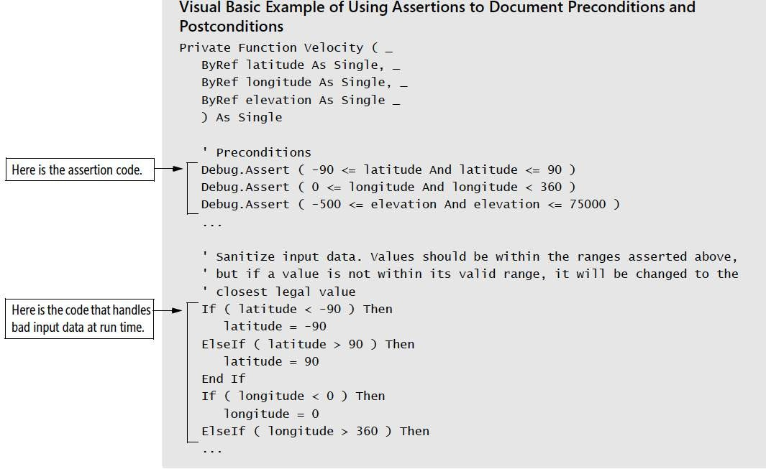
Assertions: Guidelines for Using Assertions
For highly robust code, assert and then handle the error anyway

Slide 15
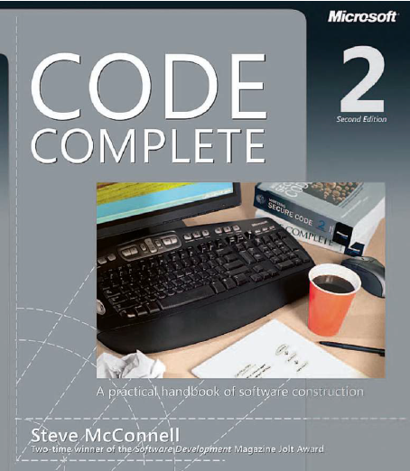
Reading
Code Complete: A Practical Handbook of Software Construction, 2nd Edition, Steve McConnell.
Chapter 8

Slide 16

Any questions? ​
Please feel free to raise your hands and ask.

